Slide 1

Professional Conduct Policy
Review with Faculty Senate

Slide 2

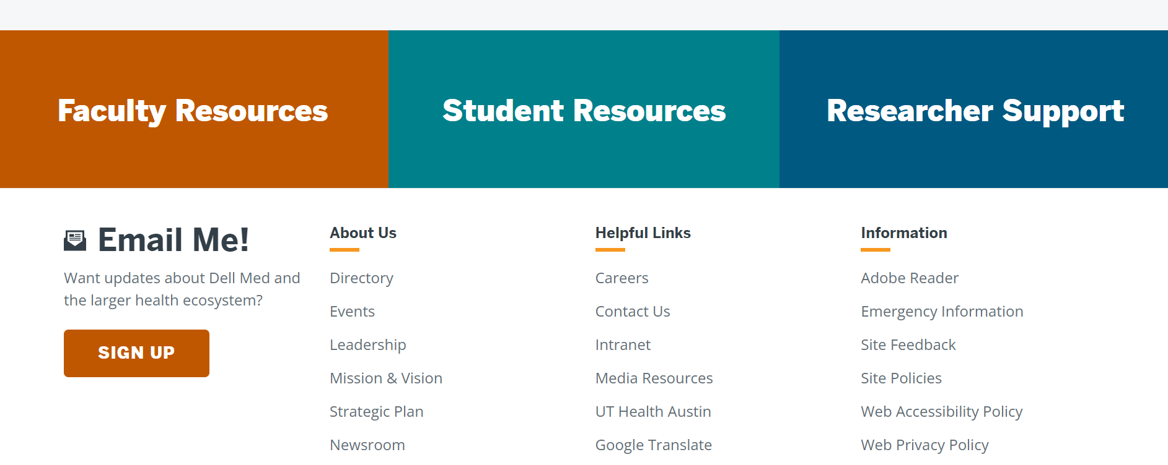


Slide 3
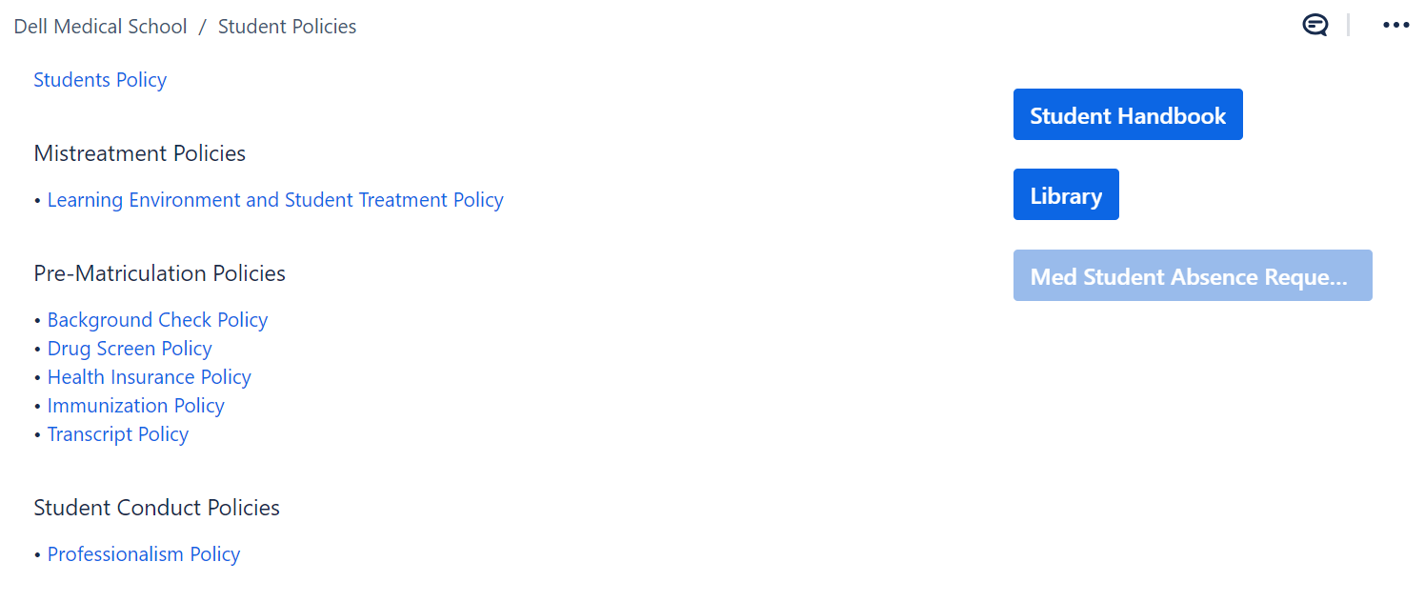

Slide 4
Professional Conduct
Professional conduct is a cornerstone of medical practice.
Professional conduct is characterized by aspects of etiquette, defined as the customary code of respectful and considerate behavior among members of a profession, and virtue, defined as behavior manifesting high moral standards.
We take the view that everyone can improve these skills. To improve, people need supportive feedback and a nurturing, growth-enabling culture and mindset.

Slide 5
Goals
Acknowledge excellence
Guide students toward growth

Slide 6
Professional Conduct Committee
Eleven (11) Members selected from Dell Medical School Faculty and/or Staff
Eight (8) Voting Members selected from Faculty and/or Staff, including one member appointed as Chair
Three (3) Non-Voting Members (Associate Dean for Student Affairs, Associate Dean for Undergraduate Medical Education, TBD)
Eight (8) Student Members

Slide 7
Subcommittees
Triage Team:
three (3) Voting Members of the Professional Conduct Committee with a specific responsibility for initial investigation of feedback reports (detailed below). •
Education and Remediation Team:
one Voting Member (Chair of the Professional Conduct Committee) and two Non-Voting Members (Associate Dean for Student Affairs, Associate Dean for Undergraduate Medical Education)

Slide 8
Report Proces
Report
Triage
Pathway
Institutional Growth Opportunity
Personal Growth Opportunity
Coaching Intervention
Personal Growth Plan
Sanction
Commendation/
Concern

Slide 9
Sanction
The concern leaves the Professional Conduct Committee and is sent to MSASC.
Could result in dismissal.

Slide 10
Questions?
https://utexas.app.box.com/file/408957446003?s=5ii2hiu2e85aryyu0e05z5vdtu7bk2m0

